Slide 1
进展
1. 将穿墙项目移植入下肢平衡系统，目前已经将训练场景单独提取出。
2. 阅读一篇VR+认知能力评估的论文。

Slide 2
Immersive 3D Virtual Reality Cancellation Task for Visual Neglect Assessment: A Pilot Study
Frontiers in Human Neuroscience (2020)
Impact Factor: 2.9

Slide 3
Introduction
1. Unilateral spatial neglect is a syndrome that frequently occurs after a stroke.
2. The severity of the symptoms often decreases within the first few months after stroke. However, in 25–35% of stroke patients, and especially in right-hemispheric stroke patients, this remission is incomplete .
3. For the diagnosis of neglect, the most commonly used tools are cancellation tasks and a commonly used measure to quantify neglect severity in cancellation tasks is the Center of Cancellation (CoC).
4. VR tasks have several advantages
(1) A VR-based setup can present more complex tasks than it is possible on article.
(2) The additional dimension available in VR allows examining the extra-personal space(远侧空间).

Slide 4
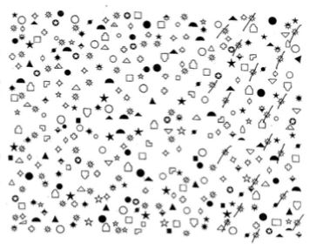
-1
0
+1

Slide 5
Introduction
5. The first hypothesis was that the new VR cancellation task and the used device setup have high usability and satisfaction and that they do not lead to side effects.
6. The second hypothesis was that the VR cancellation task can detect neglect.

Slide 6
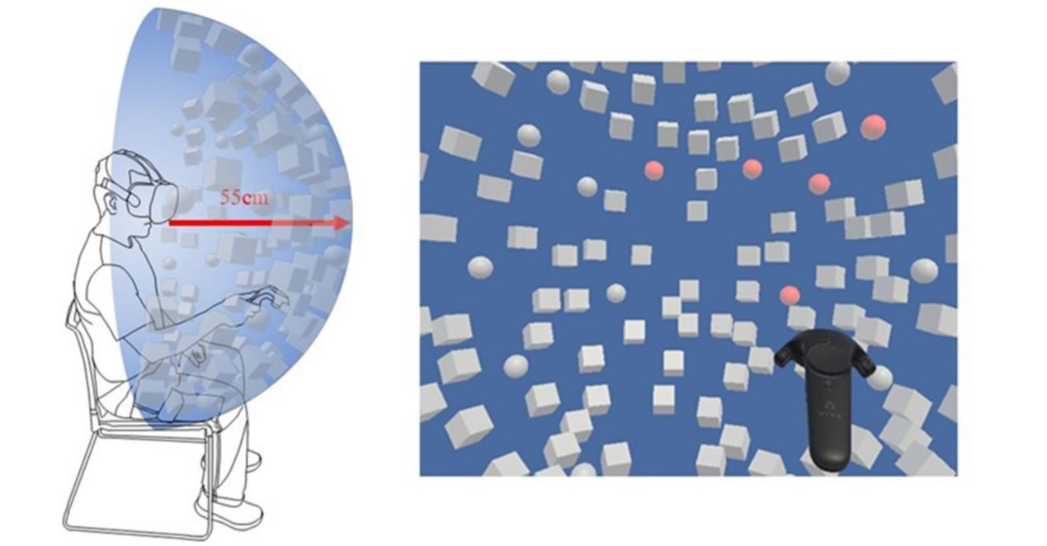
Materials and Methods
1. VR-Task
(1) A blue background and 120 objects (Figure 2), arranged within a hemisphere with a radius of 0.55 m.
(2) The presented objects were white-colored spheres (20) and cubes (100), which changed their color to red when touched with the controller.
(3) The goal of the task was to find all spheres (targets), by touching them as fast as possible.

Slide 7
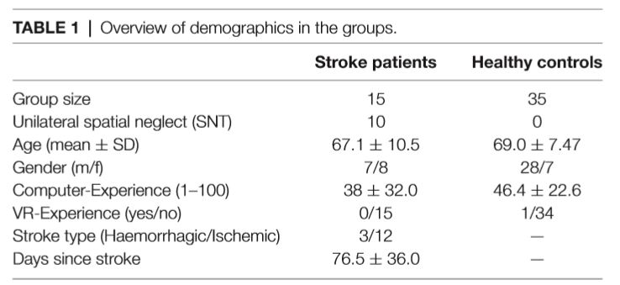
Materials and Methods
2. Participants
(1) 15 patients with right hemispheric stroke and 35 healthy controls.
(2) Stroke group were subdivided into a Neglect and a No-Neglect group according to their result in the paper-pencil cancellation task.

Slide 8
Outcome Measures
1. System Usability Scale (SUS)
2. Simulator Sickness Questionnaire (SSQ)
3. Center of Cancellation (CoC)
4. Total time
5. Percent targets found
6. Total number of targets canceled within the 5 first seconds.

Slide 9
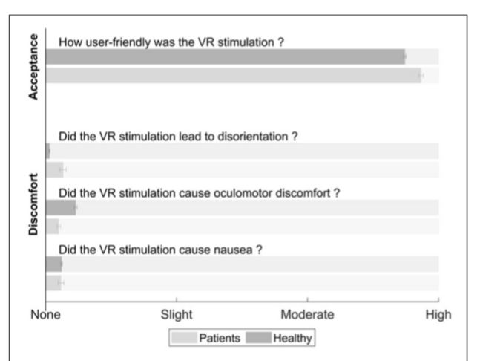
Results
1. No significant differences between the two groups (healthy controls, stroke patients) regarding acceptance, usability or adverse effects.

Slide 10
Results
2. A significant difference between the groups in both tasks.
3. The correlation between the two measures was r = 0.821.
4. The neglect symptoms were more severe when measured by the paper-pencil cancellation task.
(1) The different configuration (2D vs. 3D).
(2) VR task included a lower number of distractors and targets (100 and 20, respectively) than the paper-pencil test (40 and 240, respectively).
(3) Most patients solved the paper-pencil test within 5 to 10 min, whereas all patients performed the VR cancellation task in less than 5 min.

Slide 11
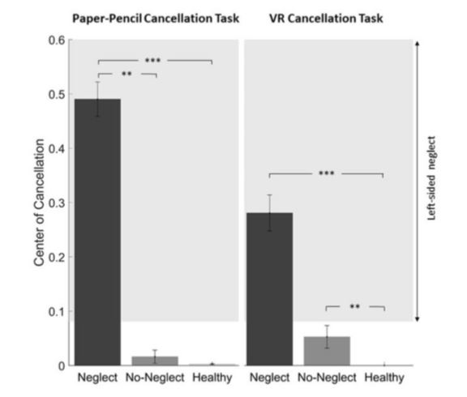
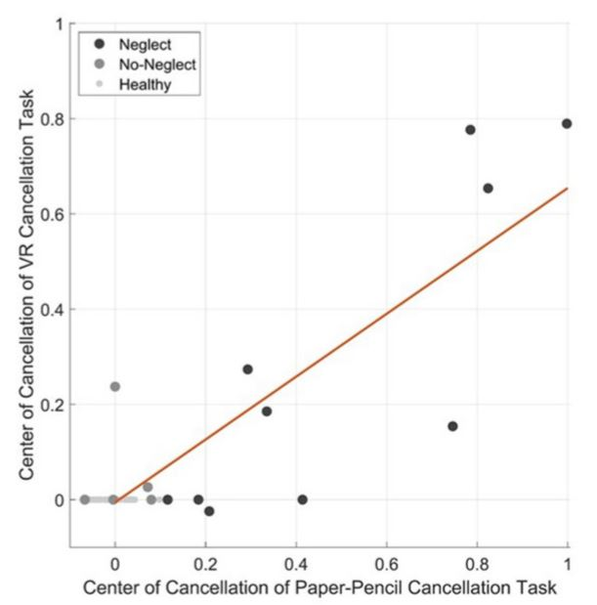

Slide 12
Results
5. The two raw measures, total time and percent targets found, were significantly different between the Neglect group and the two other groups.

Slide 13
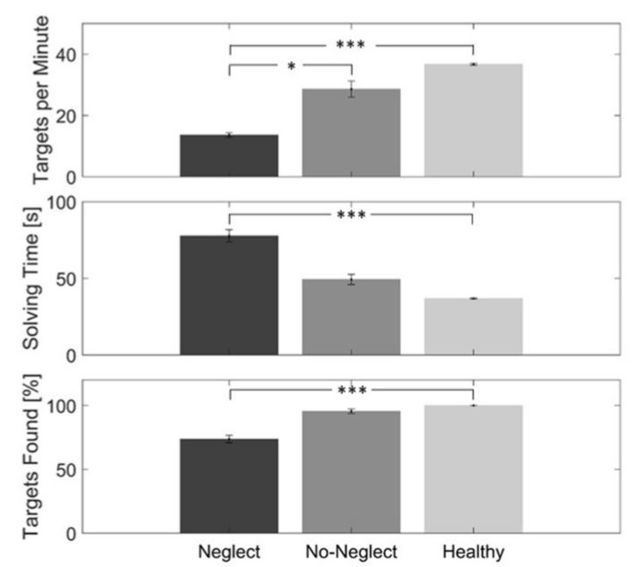

Slide 14
Results
6. A significant difference between the healthy controls and the Neglect group for the total number of targets and the targets on the left side.

Slide 15
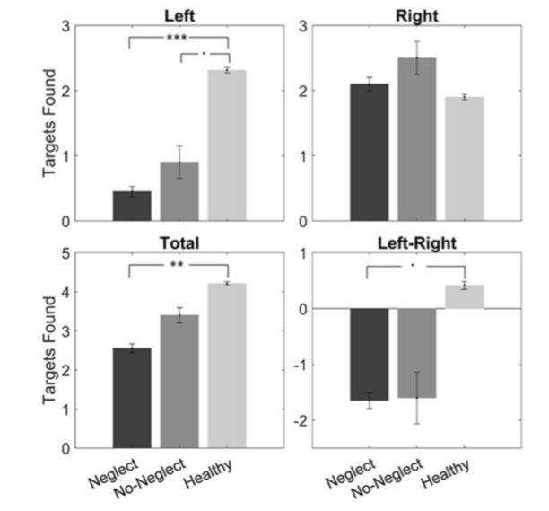

Slide 16
Conclusion
1. VR cancellation task were easy to use, highly accepted, and did not provoke any relevant side effects in stroke patients with and without neglect.
2. The questionnaire results and the high correlation between the CoC calculated from the performance in the VR cancellation task.

Slide 17
Limitations
1. Only a few patients with different levels of impairment were included.
2. Only one paper-pencil cancellation task was used.
3. Our data do not allow us to comment on the relationship between unilateral spatial neglect behavior in near and far space.

